Slide 1
Strategic Plan 2020-25 The Student Experience

Slide 2
Student Experience Team
Kyle Blasinsky ‘20 Matt Clark
Lisa Brown Cornelius Carlo DeMarchi
Aaryn Green Chelsea Gerken
Mark McCarthy (Chair) Rosanna Miguel
Julie Myers Pat Mullane
Mark Onusko John Sully
Amy Wainwright Claudia Wenzel
Andy Welki Mark Waner

Slide 3
Student Experience Team Charge
The Student Experience Team will evaluate the student experience with the goal of making it remarkable in terms of its focus on student engagement and success.
The team will review existing qualitative and quantitative measures of student satisfaction and retention, conduct benchmarking on student success initiatives and processes, consider the needs and expectations of Gen Z students and emerging student populations, and determine gaps in programs and services needed to attract, retain and graduate students of intellect, character, leadership and service.
Based on this assessment, the team will develop a set of strategic goals aimed at enhancing the student experience in an effort to support, engage and prepare students for life after John Carroll.

Slide 4
Steps Taken
Identification of drivers of student success
Identification of current strengths
Review of literature regarding trends for the future of higher education, student well-being, and student success
Identification of opportunities, obstacles, and areas for improvement
Review current institutional data on student learning experience
Identification of Emerging Themes

Slide 5
What the heck is Student Success?
Student Retention
Educational Attainment
Academic Achievement
Student Advancement
Holistic Development
Student Thriving

Slide 6
Drivers of Student Success
Support services/mechanisms for the whole person
Engagement – sense of belonging and connection
High impact experiences and practices
Financial support/literacy/planning
Equitable access to opportunities and facilities
Program connectivity/integration – in/out of classroom
Facilities/environment that promote interaction/learning
Opportunities for personal reflection and growth

Slide 7
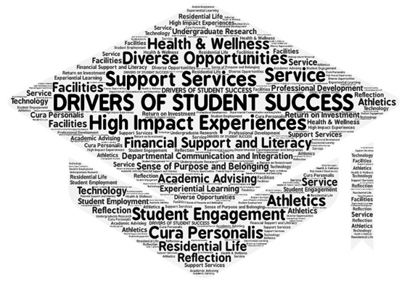

Slide 8
Emerging Themes
1. Integration and Expansion of Student Success Initiatives (i.e. advising, career services, learning resources/support)
2. Culture of Care and Support – holistic and integrated approach to student and community well-being (physical, mental, spiritual)
3. Enhanced services and support for emerging and more diverse student populations
4. Improved faculty, staff and student connections and collaboration to support the learning experience outside of the classroom
5. Movement toward a year round campus (12 month, 24/7) through use of facilities, technology, programs, course scheduling etc.

Slide 9
Emerging Themes
6. Greater focus on the lifecycle of students – scaffolding curricular and co-curricular experiences and pathways from entry to launch
7. Technology to support academic planning, skill development, engagement and communication with students
8. Provide students with personal and professional opportunities that build competencies/skills to support the University community and their fellow students and to prepare them for futures beyond John Carroll
9. Improved Campus Facilities/Infrastructure to support student engagement (e.g. Library, Housing, Dining, Athletics/Recreation and others

Slide 10
Table Discussions
Each table will start with one of the themes
Imagine and identify opportunities related to the theme.
What is needed (e.g. cultural and structural changes, resources) to make the opportunities identified a reality in terms of:
People
Places
Programs
Processes

Slide 11
Thank You!

