Slide 1
Career Workshop
Student Accessibility Services
Presenters:
Logan Vess, Assistant Director - Academic Internships
Subi Aierken, Career Advisor

Slide 2
Today’s Agenda
Job Searching
Setting career goal
Employment resources
Resume
Cover Letter
Interview
Typical Interview Process
Interview etiquette
Disclosing disability

Slide 3
JOB SEARCHING

Slide 4
Career Goal Setting
Job/internship title/position title
Industry/career fields
Resources to guide you in this process
Notes:
Here are some recourse that can use as a part of your job search.
O*Net - Comprehensive summary of job titles. occupational quick search; human resources hit enter; under the quick search you see the summary. Allows you to see tasks, technology skills (you can click on the plus sign), Knowledge; Skills, Abilities, Work Activities; Job Zone (give you an overall idea of what you are doing); Related occupation; Wages and employment trends (transparent, click on the local); projected growth; (how fast is this particular position grow?) Overall, this is a fantastic way of finding out what you need - DEMO
Occupational Outlook Handbook - published by US Bureau of Labor Statistics, contains career related information for hundreds of occupations. Microbiologist example - DEMO
What Can I do with my major - Learn typical career areas and types of employers that hire in these fields, as well as strategies to make you a more marketable candidate. - DEMO

Slide 5
Job & Internship Resources
Notes:
the Department labor’s getting hired.com and job accommodation network, a disability employment site featuring postings from companies such as American Red Cross, Bank of America, Capital One and so on.
the Federal government is actively recruiting and hiring people with disabilities, and you can find those opportunities with the federal government on USAJOB. Similarly, Social Security Administration, a government agency, is also looking to hire people with disabilities. There are special hiring authorities and programs you can apply. For example the ticket to work program is designed to help individuals improve their earning potential and prepare for long-term career success.
AbilityJobs is a leading career website for people with disabilities who are seeking for employment opportunities and it’s free!
NTI@Home is a non-profit telecommuting institution that train and assist people with disabilities to be employed with industries such as technical services and billing / call center job that you can work from home! There is no cost to register and once you are registered you will also then receive a Remote Call Center Agent training from them. The training consists of a self-paced course in the basics of working in a call center and related technologies. This is followed up with a live 3-day workshop that allows for hands-on practice with call center skills and roleplaying with the kinds of calls to expect. None of those services have a cost for registrants.
RecruitDisability.org is a national website support individuals with disabilities to look for jobs opportunities.

Slide 6
Job & Internship Resources
Notes:
InternshipFinder - another great recourse for college students to apply for different opportunities.
AAPD- a non-profit organization that provide summer internship for students with disabilities in Washington D.C. to work with congressional offices and federal agencies
WayUp - a great recourse to connect students with a wide range of internship opportunities with startup, 500 fortune companies and anything in between. Once you create your account profile and upload your information, and start applying for internships. The companies normally get back to you within 24 hours to potentially schedule an interview.
Bender Consulting Services - funded by Joyce Bender who lives with multiple disabilities, and is currently serving as the CEO of the company. Bender Consulting Service provide a wider range of expertise related to disability employment and the company itself has a wide variety of full/part-time positions that people can apply to from IT, Human Resources, Customer Services, Health Care to Sales and Recruitment internship opportunities.

Slide 7
RESUME

Slide 8
IMPORTANT THINGS TO CONSIDER
Blank word document
Font:
11 – 12 pts.
Black
Consistent with resume
1 page in length
Example Fonts
Arial
Garamond
Georgia
Times New Roman

Slide 9
ORGANIZING CONTENT
Reverse chronological
Most relevant achievement first
Be aware of whitespace

Slide 10
CORE COMPONENTS
Heading
Education
Experience
Additional Sections
Skills

Slide 11
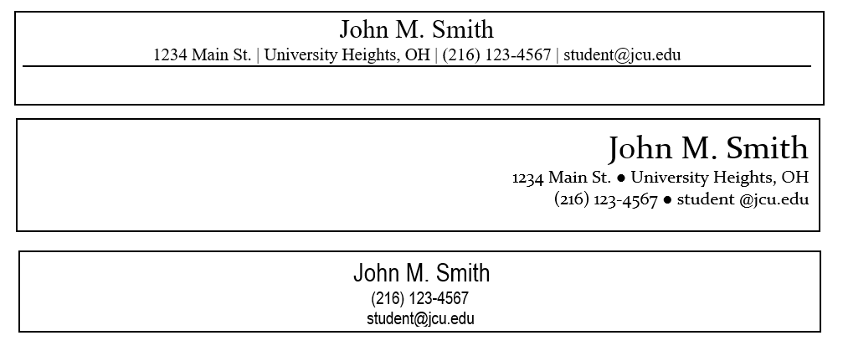
HEADING
EXAMPLES:

Slide 12
EDUCATION
John Carroll University University Heights, OH
Bachelor of Arts May 2023
Major: Education | Minor: Spanish
GPA: 3.6
Dean’s List: 3 Consecutive Semesters
Regent’s University London, England
Study Abroad Program September 2022
Relevant Coursework: Methods in Reading Education, Reading Assessment and Intervention, Literacy Intervention & Assessment, and Multicultural Education

Slide 13
EXPERIENCE
Organization/Program Name City, State
Job Title Start Date - End Date
Use action - result statements
Highlight special projects that make you stand out
Quantify results. Avoid vague descriptions
Example:
Cleveland Clinics Cleveland, OH
Community Health Coordinator May 2019 - May 2020
Managed a team of 15 residents, using a grassroots approach to work collectively and provide information on behavioural health issues impacting the community
Utilized health assessments from various stakeholders to engage the community towards action-based health prevention plans
Researched and educated community regards to mental health and substance use
ACTION
RESULT: What/How/Why

Slide 14
CONTENT: BULLET POINTS
Example Bullet Point
Coordinated annual class service trip for 50+ students to various elementary schools in the community generating a total of over 250 volunteer hours
Action Verbs
Analyzed
Balanced
Coordinated
Developed
Drafted
Facilitated
Generated
Implemented
Increased
Maintained
Promoted
Reviewed
Project
Action
Result

Slide 15
ADDITIONAL SECTIONS
OTHER WORK EXPERIENCE
CAMPUS INVOLVEMENT
CLINICAL EXPERIENCE
COMPUTER SKILLS
EXTRA CURRICULAR ACTIVITIES
HONORS & AWARDS
FIELD WORK
RELEVANT COURSEWORK
RELEVANT PROJECTS
SERVICE

Slide 16
ADDITIONAL SECTIONS EXAMPLES
CAMPUS INVOLVEMENT:
Finance Club September 2023 - Present
Member
Attend meetings and events to network with members of the club and JCU alumni working in the finance field to learn about career opportunities and options
Residence Life August 2023 - May 2025
Service Coordinator and Resident Assistant
Coordinated annual class service trip for 50+ students to various elementary schools in the community generating a total of over 250 volunteer hours
Toys for Tots May 2024 - August 2024
Activities Coordinator
Collected and tracked all monetary donations each day through a secure online database
HONORS AND AWARDS:
Faith and Fellowship Service Award May 2023
Presidential Scholarship February 2025

Slide 17
SKILLS
Unique Skills
Objective Hard Skills
Computer Software Skills
EXAMPLES:
Skills
Fluent in Spanish
Knowledge of Bluebeam Revu and reading blueprints
Skills
Social Media Accounts, Hootsuite, Sprout, Adobe Photoshop, InDesign, CMS Software

Slide 18
TIPS
Proofread
Submit as a PDF
Remove High School

Slide 19
COVER LETTER

Slide 20
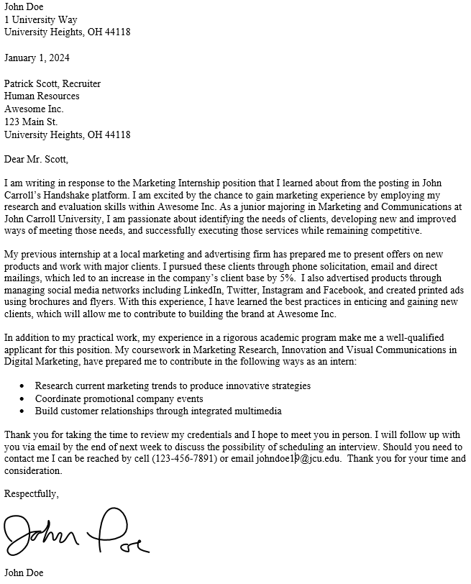
7 COMPONENTS
Header
Date
Employer’s Information
Greeting
Main Content: - Introduction Paragraph
- 2-3 Body Paragraphs
Closing Paragraph
Signature

Slide 21
HEADER
Your First and Last Name
Street Address
City, State Zip Code

Slide 22
DATE
January 30, 2019
1/30/2019

Slide 23
Your Name
Street Address
City, State Zip
Date
Employer’s Name,Title
Department or Division
Company Address
Company City, State Zip Code
Dear Mr./Ms. Last Name,

Slide 24
BUSINESS LETTER FORMAT
10 - 12 pt font
0.5 - 1 inch margins
Left-aligned
Single-spaced
Consistent with resume format

Slide 25
FIRST PARAGRAPH
Introduce yourself
What
How did you hear of the job opening?
Why (your interest)
“I am writing in regards to the [Insert position title] at [Insert organization's name]
[...] “because of this past experience, I am excited to be applying for the Youth Development Coordinator position at Cleveland Clinics”

Slide 26
2ND PARAGRAPH – BODY
Market Yourself!
Present your experiences in relation to the job
How your accomplishments prepared you to meet the requirements of the job
Identify the skills you have and how it relates to the job
In short: Highlight your skills, education and experience and use familiar
language from the job posting.

Slide 27
3RD PARAGRAPH – BODY
Your knowledge
Your skills
Correlate your skills to the needs of the industry/organization
Your experiences
Additional information

Slide 28
IF You Wish to Express Your Disability
(Resumprime, 2021)
Image from Resumeprime https://www.resumeprime.com/resume-for-job-seekers-with-disability

Slide 29
CLOSING PARAGRAPH
Thank the employer for reviewing your credentials
Indicate your desire for an interview and specifically when and how you are going to contact the employer
State your phone number and email address should they need to contact you

Slide 30
SIGNATURE
Sincerely,
John Doe

Slide 31
TIPS
Clear, concise, and concrete
Proofread
Write a new targeted cover letter for each job

Slide 32
INTERVIEW

Slide 33
What is an Interview?
An interview is a conversation between you and 1 or more members from an organization to discuss your qualifications for a job opportunity.

Slide 34
Types of Interviews
Phone
Robo
Interview
Video
On-site
1 or more Interviewers
Recorded answer by video
1 or more interviewers
individual /group/panel

Slide 35
Take notes before and during the interview
Don not read from your notes
Be comfortable with silent pauses
Never place an employer on hold
On-Site Interview Tips
Arrive 15 minutes early
Walk in the door 10 minutes prior to start time
Be respectful
Firm handshake
Introduce Yourself

Slide 36
Interview Etiquette
Pay attention
Your body language and their body language

Slide 37
Take notes before and during the interview
Don not read from your notes
Be comfortable with silent pauses
Never place an employer on hold
Phone Interview Tips
Refer to your notes without reading word-for-word
Be comfortable with silent pauses
Never use speaker phone
Never place an employer on hold
Harder to build rapport so be energetic and keep them engaged
Stand up to maintain energy
Take notes before and during the interview

Slide 38
Take notes before and during the interview
Don not read from your notes
Be comfortable with silent pauses
Never place an employer on hold
Video and Robo Interview Tips
Account name should be listed as your First and Last Name
Close browser
Close computer applications
No Notifications
Treat as on-site interview
Facial expressions
Eye contact
Appearance
Camera/Audio check

Slide 39
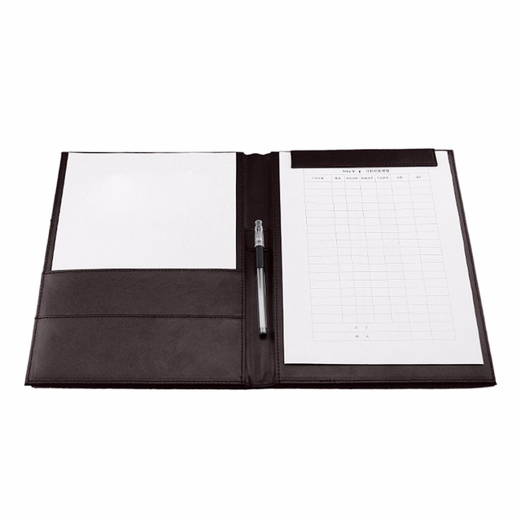
Items to bring
You should Bring…
Resume
Use to reference
Give to interviewers
Padfolio with Pad and pen
Samples of work
You should leave your cell phone and personal items
Resume
Padfolio with Pad and pen
Samples of work
You should leave your cell phone and personal items

Slide 40
Decision around Disclosing Disability
It is YOUR decision
Request a reasonable accommodation
*Apparent disability & Hidden disability

Slide 41
Know Your Rights!
The Americans with Disabilities Act (ADA)
The Rehabilitation Act

Slide 42
What to Disclose
General information regarding your disability
Reason you are disclosing
Accommodations worked for you previously
Type of accommodations you anticipate needing in the workplace

Slide 43
To Whom?
“Need-to-know” basis
Assist in your accommodation request
(e.g. supervisor, hiring manager)

Slide 44
When to Disclose
There is not a single right time
When it is appropriate for you
Cover letter
Before, during or after an interview
After receiving the job offer
During your course of employment
Never

Slide 45
How to Disclose
Strength-based and Proactive approach
Focus on your strengths and qualifications
Discuss your need
Practical suggestions
Preparation
Practice
Disclosure script

Slide 46
Client’s Profile
Name: Jordan
Interview position: Full-time Administrative Assistant with TSW Manufacturing
Her Concern: A year gap on her resume, lost jobs in the past
Anxiety and Depression, sensitive to noises
Link to the Video

Slide 47
Dialogue
“ I had a health-related condition and I needed that time for myself. But I am ready to come back to the workplace, and I have experiences in .... ”
“Can you describe the work environment, and how is the noise level ?”
“I understand the admin role requires me to have a great customer service skills” (Then offered options and ways to manage noise)
“I can turn away my desk from a noisy hallway but setting up a mirror so that I can still see if someone is trying to get my help, or using a noise cancelling headphone in order to effectively do my job”

Slide 48
Q & A

Slide 49
We’re Virtual! Set up an appointment with a career advisor today on Handshake:
jcu.joinhandshake.com/appointments
Spring 2021 Drop-In Hours: Mondays from 7:00-8:00 p.m. and Wednesdays from 1:00-3:00 p.m. Zoom: https://johncarrolluniversity.zoom.us/j/98854874557
Email us at: careerservices@jcu.edu Or Call: 216.397.4237 Open Monday through Friday 8:30 am to 5:00 pm

Slide 50
References
Youth, disclosure, and the workplace why, when, what, and how. (n.d.). Retrieved March 09, 2021, from https://www.dol.gov/agencies/odep/publications/fact-sheets/youth-disclosure-and-the-workplace-why-when-what-and-how
R. (2020, October 22). Resume for job seekers with disability that attracts interviews. Retrieved April 09, 2021, from https://www.resumeprime.com/resume-for-job-seekers-with-disability/#:~:text=You%20don't%20have%20to,so%20in%20your%20cover%20letter.
Bureau of Labor Statistics, U.S. Department of Labor, Occupational Outlook Handbook, Grounds Maintenance Workers,
at https://www.bls.gov/ooh/building-and-grounds-cleaning/grounds-maintenance-workers.htm (visited April 09, 2021)
National Collaborative on Workforce and Disability for Youth. The 411 on Disability Disclosure: A Workbook for Youth with Disabilities
National Collaborative on Workforce and Disability for Youth. The 411 on Disability Disclosure: A Workbook for Families, Educators, Youth Service Professionals, and Adult Allies Who Care About Youth with Disabilities

